Slide 1
A Defense of Abortion Judith Jarvis Thomson

Slide 2
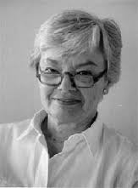
Judith Jarvis Thomson
American Moral philosopher
Born in 1929
Attended Columbia University

Slide 3
Is a fetus a person?
She thinks that the arguments that most opponents on abortion focus too much time on when and if a fetus is a person
In her writings she is more focused on the next step which is the impermissibility of abortion.

Slide 4
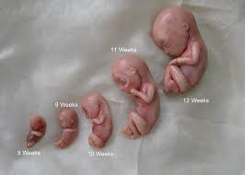
For this article she considers that a fetus is a person at time of conception

Slide 5
Right to Life or a woman’s right to her body?
Volunteer Vs. Not volunteering
*Violinist
*Rape
*Mother on bed rest through entire pregnancy
*Mother’s life at risk

Slide 6
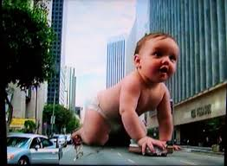
Extreme View
Risk of mother’s life
Do we grant women the right to their bodies and what happens in and to them?

Slide 7
Finds these theses are false
A mother can’t be held accountable for “murder” in the act to save her own life

Slide 8
1. self-defense
2. Bystanders don’t help/participate
3. Woman’s life not a stake

Slide 9
Right to Life
“Does not guarantee having either a right to be given the use of or a right to be allowed continued use of another person’s body-even if one needs it for life itself”

Slide 10
Emendations
Right to life consists not in the right to be killed but rather in the right not to be killed unjustly
Rape
Voluntary sex

Slide 11
Indecent to refuse?
What if
No risk
No harm

Slide 12
Kitty Genovese
Murdered in front of 38 people and no one did anything
No one is legally obligated to get involved

Slide 13
What kind of Samaritan are you?
Women by law are compelled to be good Samaritans to their unborn children inside their bodies.

Slide 14
Special Responsibility
We have no special responsibility for any other person(s) unless we assume it.
If all precautions are taken and pregnancy occurs - no responsibility is given
It is assumed but not required

Slide 15
Conclusions
She doesn’t argue that abortion is not impermissible but that it is not always permissible

Slide 16
References to the readings
Subject Value
Harm Approach
Gradualist
Metaphysical gradualism

Slide 17
Conclusion

