Slide 1
No Place Like Home Invasional Meltdown in the New Pangaea
Kyle Burchett
University of Kentucky

Slide 2
Unfortunately, it’s not a dream. . .

Slide 3
More than 120,000 non-native species of plants, animals and microbes have invaded:
United States (~50,000, $137 Billion/yr)
United Kingdom
Australia
South Africa
India
Brazil
Non-native species invasions in these nations are estimated to cause more than $314 billion per year in damages.
(Pimentel et al. 2001)

Slide 4
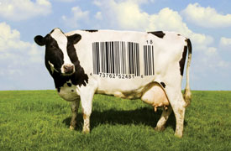
Some introduced species are ‘beneficial’ and provide more than 98% of the world’s food supply.
Corn
Wheat
Rice
Cattle
Poultry
(Pimentel et al. 2001)

Slide 5
In some cases, however, even the introduction of a single species, like the brown tree snake (Boiga irregularis), can lead to a cascade of extinctions.
(Atkinson, 1996; Pimentel et al., 2000)

Slide 6
In the case of Homo sapiens, the global invasion that has taken place over the last 50,000 years has radically accelerated the otherwise ‘natural’ background rate of species extinctions.
One species is extirpated every 20 minutes.
This rate is more than one thousandfold greater than the natural background rate.
(Pimm et al. 1995, Wilson 1992)

Slide 7
Invasional Meltdown: The process whereby an introduced species facilitates the establishment of another non-native species, which then facilitates the establishment of another invader, and so on. . . .
(Simberloff and Von Holle 1999)
Homo sapiens is unquestionably the Earth’s champion facilitator of biotic reassembly.

Slide 8
Nevertheless, Homo sapiens is yet unclassified as ‘invasive’ or ‘exotic’ by most invasion ecologists.

Slide 9
Homo sapiens as quasi-divine. . . ?
. . . or some other metaphysical assumption that establishes our species as fundamentally separable from all other life forms that have ever existed (or ever will exist) on the Earth?

Slide 10
The whole attitude of ‘man against the world’ . . . the monstrous stupidity of this attitude has finally dawned on us and we are sick of it; we laugh as soon as we encounter the juxtaposition of ‘man and world,’ separated by the sublime presumptuousness of the little word ‘and’!
Friedrich Nietzsche GS:346

Slide 11
What must a species do to be considered ‘invasive’?
Presumably, be nonhuman and cause harm to Homo sapiens or disrupt species and ecosystems in such a way that they are deemed less valuable to humans.

Slide 12
Ned Hettinger suggests, “Exotics are best characterised ecologically as species that are foreign to an ecological assemblage in the sense that they have not significantly adapted with the biota constituting that assemblage or to the local abiotic conditions.”
However, “Exotic species become natives when they have ecologically naturalised and when human influence over their presence in an assemblage (if any) has washed away.”
(Hettinger 2001:193)

Slide 13
It is interesting to note that while, according to Hettinger’s criteria, Homo sapiens should be considered ‘exotic,’ humans can never be considered ‘naturalised’ to any of Earth’s ecosystems.
This turns out to be pretty bad news for us, since Hettinger recommends zero tolerance for species that are, at present, considered ‘exotic.’ Presumably, both Homo sapiens and the mostly exotics that we depend on for our sustenance are not to be tolerated.

Slide 14
Mark Woods and Paul Moriarty offer a less problematic set of criteria to be taken as cluster concepts:
The Human Introduction Criterion
The Evolutionary Criterion
The Historical Range Criterion
The Degradation Criterion
The Community Membership Criterion
“The more of these traits a species has, the more likely we are to think of it as exotic.”
(Woods and Moriarty 2001:175)

Slide 15
Biotic Homogenization in the New Pangaea
“Cultivation of species is a major mechanism of homogenization. Monocultures for food, timber and many other plant products are increasingly widespread in many parts of the world.”
(McKinney 2005:122)

Slide 16
Sometimes, local and regional biodiversity are increased by the introduction of exotic species, leading thinkers such as Mark Sagoff (2005) to claim that there is no need to be concerned about the problem of bioinvasions.
“The problem for biodiversity conservation is that despite these local species enrichments, global biodiversity continues to decline. Furthermore, because these locally diverse exotic species are typically widespread species, there is a global trend of increasing homogenization (Rosenzweig 2001a, 2001b).”
“The general public, and most policymakers, tend to think mainly at local scales (Ornstein and Ehrlich 1989).”
(McKinney 2005:124-125)

Slide 17
Emerging Infectious Diseases
“In the past three decades, previously unknown diseases have surfaced at a pace without precedent in the annals of medicine. Indeed, such a renegotiation of evolutionary agreements between microbes and humans and other species may not have occurred since hunters and gatherers became herders—when domestication of animals triggered such a ‘spillover’ of animal microorganisms.”
(Epstein et al. 2003:A506)

Slide 18
The Earth’s underprivileged human populations are particularly susceptible to the dangers of biodiversity loss and the resultant loss to ecosystem services that ensure their health and livelihoods.
“Because of their low economic and political power, the less privileged sectors cannot substitute purchased goods and services for the lost ecosystem benefits and they typically have little influence on national policy.”
(Díaz et al. 2006:1302-1303)

Slide 19
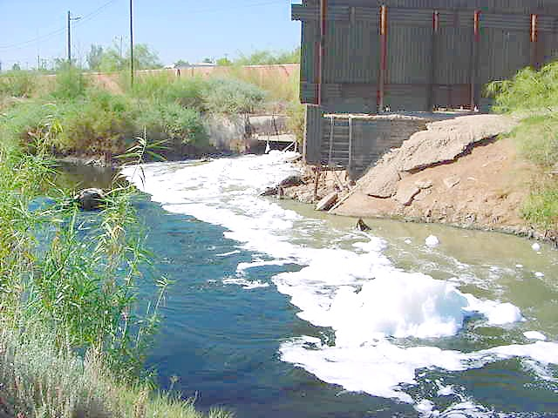
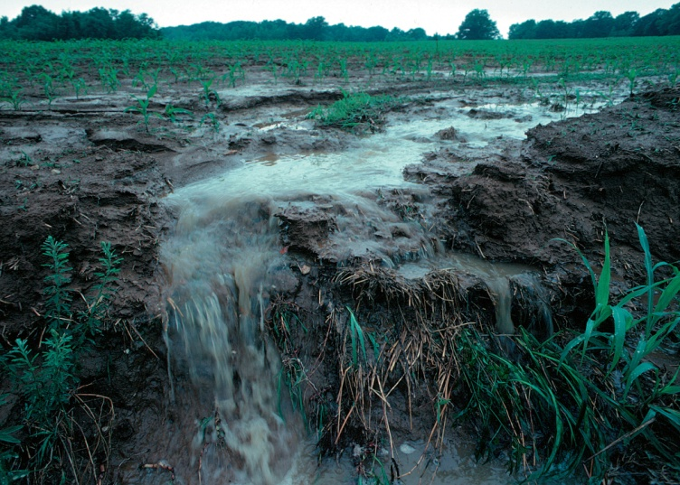
“When the quality of water deteriorates as a result of fertilizer and pesticide loading by industrial agriculture, the poor are unable to purchase safe water. When protein and vitamins from local sources, such as hunting and fruit, decrease as a result of habitat loss, the rich can still purchase them, whereas the poor cannot.”
(Díaz et al. 2006:1302-1303)

Slide 20
“Biodiversity change is therefore inextricably linked to poverty, the largest threat to the future of humanity identified by the United Nations. This is a sobering conclusion for those who argue that biodiversity is simply an intellectual preoccupation of those whose basic needs and aspirations are fulfilled.”
(Díaz et al. 2006:1302-1303)

