Slide 1
“On the moral and legal status of abortion” by Mary Anne Warren
Presentation by Abby Spalding

Slide 2
Defining the moral status of abortion
“The act that a woman performs in voluntarily terminating, or allowing another person to terminate, her pregnancy, and the legal status that is appropriate for this act.”
Also assuming that “a fetus is not a person, hence not the sort of entity to which it is proper to ascribe full moral rights”.

Slide 3
Two common arguments of pro-abortionists
1) Point to the terrible side effects of restrictive laws (i.e. terrible side effects due to illegal abortions)
2) Point out that poor women suffer most as result of these laws, stating that “to deny a woman access to abortion is to deprive her of her right to control her own body”.

Slide 4
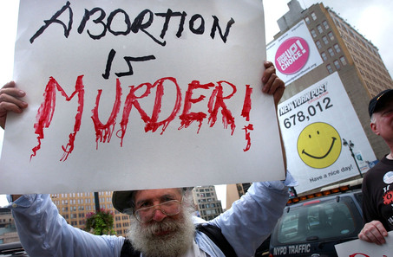
Arguments against the pro-abortionist
1) “Murder is wrong regardless of the consequences prohibiting it”
2) Mere ownership does not give me the right to kill innocent people whom I find on my property, and indeed I am apt to be held responsible if such people injure themselves while on my property”.

Slide 5
How do you determine the humanity of a being?
The Catholic Church says:
“… it is wrong to kill humans, however poor, weak, defenseless, and lacking in opportunity to develop their potential they may be. It is therefore morally wrong to kill infants. Similarly, it is morally wrong to kill embryos”.
Theologians’ criterion of humanity:
“That whoever is conceived of human beings is human.”
Assuming that “if a fetus is human then abortion is wrong for exactly the same reason that murder is wrong”.

Slide 6
Judith Thompson’s arguments
“Even if we grant the antiabortionist his claim that a fetus is a human being, with the same right to life as any other human being, we can still demonstrate that, in at least some and perhaps most cases, a woman is still under no moral obligation to complete an unwanted pregnancy”.

Slide 7
In this paper Warren will:
1) determine what moral rights, if any, a fetus possesses
2) find a just solution to the conflict between whatever rights the fetus may have, and the rights of the woman who is unwillingly pregnant

Slide 8
Part One.

Slide 9
Thompson’s claims
“Even if a fetus has full moral rights, abortion is still morally permissible, at least sometimes, for some reasons other than to save a woman’s life.”
Violinist example.
Antiabortionists would say “you are obligated to stay in bed with the violinist: for all people have a right to life, and violinists are people, therefore it would be murder for you to disconnect yourself from him and let him die.”
Proabortionists would say “it would certainly be commendable of you to agree to save the violinist, but it is absurd to suggest that your refusal to do so would be murder.”

Slide 10
Distinction of appropriateness
“It would be ‘indecent’ for a woman in seventh month to obtain an abortion just to avoid having to postpone a trip to Europe”.
VS
“A sick and desperately frightened schoolgirl pregnant due to rape may of course choose abortion, and that any law which rules this out is an insane law”.
Conclusion to this point: “indeed the choice of a pregnancy due to rape, as an example of a case in which abortion is permissible even if a fetus is considered a human being, is extremely significant … in all other cases, we would almost certainly conclude that it was necessary to look carefully at the particular circumstances in order to determine the extent of the woman’s responsibility and hence the extent of her obligation”.

Slide 11
Alternate violinist example
“Violinists are peculiarly prone to the sort of illness the only cure for which is the use of someone else’s bloodstream for nine months, and that because of this there has been formed a society of music lovers who agree that whenever a violinist is stricken they will draw lots and the loser will, by some means, be made the one and only person capable of saving him.”
Would YOU be obligated to cooperate if your name was drawn, assuming that you had previously put your name in?

Slide 12
Warren’s conclusion to this situation
“X has no more right to bring into existence, either deliberately or as a foreseeable result of actions he could have avoided, a being with full moral rights y, and then refuse to do what he knew beforehand would be required to keep that being alive, than he has to enter into an agreement with an existing person, whereby he may be called upon to save that person’s life, and then refuse to do so when so called upon. Thus x’s responsibility for y’s existence does not seem to lessen his obligation to keep y alive, if he is also responsible for y’s being in a situation in which only he can save him”.
The basis of her conclusion is based on “the realization that a fetus is not a person, and thus does not have a full-fledged right to life”.

Slide 13
Part Two.

Slide 14
The moral status of abortion
“How are we to define the moral community, the set of beings with full and equal moral rights, such that we can decide whether a human fetus is a member of this community or not? What sort of entity, exactly, has the inalienable rights to life, liberty, and the pursuit of happiness?”

Slide 15
The definition of “Human”
The traditional argument:
1) it is wrong to kill innocent human beings
2) fetuses are innocent human beings
3) it is wrong to kill fetuses
Moral sense of “human”:
(1) is a self-evident moral truth, and avoids begging the question about abortion, only if “human being” is used to mean something like “a full-fledged member of the moral community.
Genetic sense of “human”:
The sense in which a member of the species is a human being, and no member of any other species could be.

Slide 16
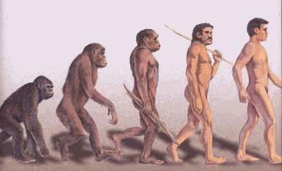
Defining the moral community
“The moral community consists of all and only people, rather than all and only human beings”.
Anthropological view of people:
Something that has “religion, art, and the manufacturing tools, weapons, or shelters, since these have been used to distinguish our human from our prehuman ancestors”.

Slide 17
Traits most central to the concept of personhood:
1) consciousness (of objects and events external and/or internal to the being), and in particular the capacity to feel pain
2) reasoning (the developed capacity to solve new and relatively complex problems)
3) self-motivated activity (activity which is relatively independent of either genetic or direct external control)
4) the capacity to communicate, by whatever means, messages of an indefinite variety of types, that is, not just with an indefinite number of possible contents, but on indefinitely many possible topics
5) the presence of self-concepts, and self-awareness, either individual or racial, or both

Slide 18
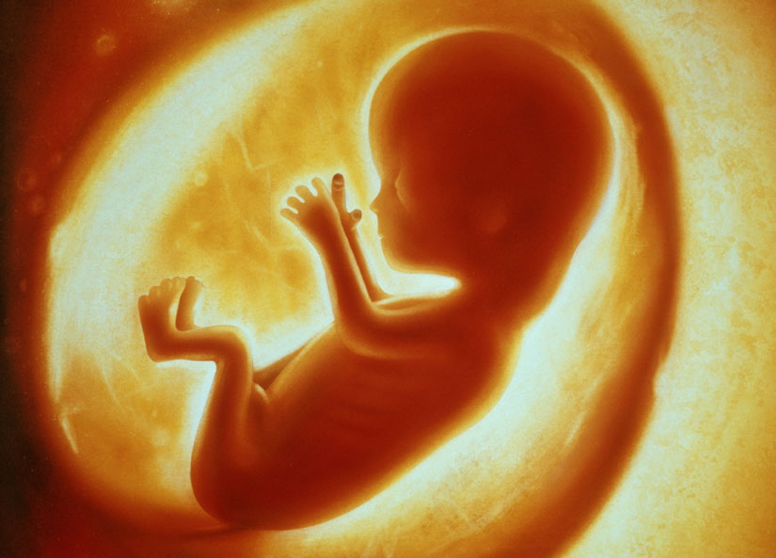
Fetal development and the right to life
1) How like this paradigm, in particular how far advanced since conception, does a human being need to be before it begins to have a right to life by virtue, not of being fully a person as of yet, but of being like a person?
2) To what extent, if any does the fact that a fetus has the potential for becoming a person endow it with some of the same rights?

Slide 19
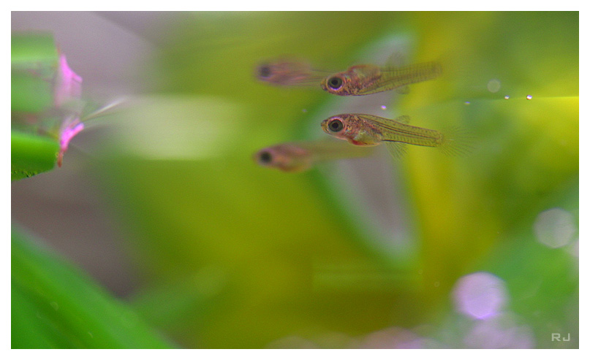
When does a fetus have a right to life?
“The human individual develops biologically in a continuous fashion … the rights of a human person might develop in the same way”.
A 7-8 month old fetus is somewhat more personlike in the the context that it can feel and respond to pain, showing that its brain is quite active, although it is not fully conscious, cannot reason, does not engage in self-motivated activity and has no self-awareness.

Slide 20
“Thus, since the fact that even a fully developed fetus is not personlike enough to have any significant right to life on the basis of its personlikeness shows that no legal restrictions upon the stage of pregnancy in which an abortion may be performed can be justified on the grounds that we should protect the rights of the older fetus”.

Slide 21
Potential personhood and the right to life
A fetus does not resemble a person in a way that we can attribute them the same rights … BUT, “what about its potential, the fact that if nurtured and allowed to develop naturally it will very probably become a person?”
“But even if a potential person does have some prima facie right to life, such a right could not possibly outweigh the right of a woman to obtain an abortion, since the rights of any actual person invariably outweigh those of any potential person, whenever the two conflict.”

Slide 22
Space traveler example
“Imagine that the whole project will take only seconds, and that its chances of success are extremely high, and that our explorer knows all of this, and also knows that these people will be treated fairly. I maintain that in such a situation he would have every right to escape if he could, and thus to deprive all of these potential people of their potential lives; for his right to life outweighs all of theirs together, in spite of the fact that they are all genetically human, all innocent, and all have a very high probability of becoming people very soon, if only he refrains from acting… Nor would he be obligated to stay if he had gotten captured (thus bringing all these people-potentials into existence) because of his own carelessness, or even if he had done so deliberately knowing the consequences. Regardless of how he got captured, he is not morally obligated to remain in captivity for any period of time for the sake of permitting any number of potential people to come into actuality”.

Slide 23
Postscript on Infanticide
“It may appear to justify not only abortion but infanticide as well. A newborn infant is not a great deal more personlike than a nine month fetus, and thus it might seem that if late-term abortion is sometimes justified, then infanticide must also be sometimes justified. Yet most people consider that infanticide is a form of murder, and thus never justified”.
“The deliberate killing of viable newborns is virtually never justified. This is in part because neonates are so very close to being persons that to kill them requires a very strong moral justification as does the killing of dolphins, whales, chimpanzees, and other highly personlike creatures. It is certainly wrong to kill such beings just for the sake of convenience, or financial profit, or “sport.””

Slide 24
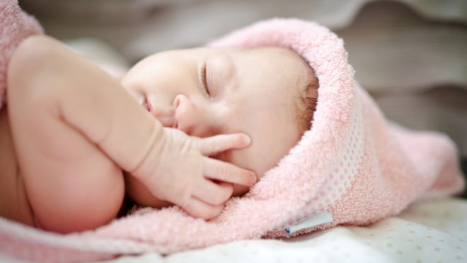
The difference between an infant and a fetus
“As a potential source of pleasure to some family, a viable fetus is just as valuable as a viable infant. But there is an obvious and crucial difference between the two cases: once the infant is born, its continued life cannot (except, perhaps, in very exceptional cases) pose any serious threat to the woman’s life or health, since she is free to put it up for adoption, or, where this is impossible, to place it in a state-supported institution.”

Slide 25
When infanticide might be acceptable
“When an infant is born into a society which-unlike ours-is so impoverished that it simply cannot care for it adequately without endangering the survival of existing persons, killing it or allowing it to die is not necessarily wrong-provided that there is no other society which is willing and able to provide such care”.
“When an infant is born with such severe physical anomalies that its life would predictably be a very short and/or very miserable one, even with the most heroic of medical treatment, and where its parents do not choose to bear the often crushing emotional, financial and other burdens attendant upon the artificial prolongation of such a tragic life, it is not morally wrong to cease or withhold treatment, thus allowing the infant a painless death”.

Slide 26
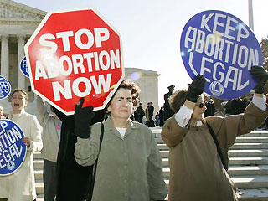
Conclusion
“Abortion is not an isolated moral issue; to fully understand the moral status of abortion we may have to reconsider other moral issues as well, issues not just about infanticide and euthanasia, but also about the moral rights of women and of nonhuman animals”.

