Slide 1
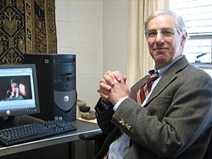
The Termination Thesis
Fred Feldman
Midwest Studies in Philosophy
XXIV, 2000
pp. 98 – 115

Slide 2
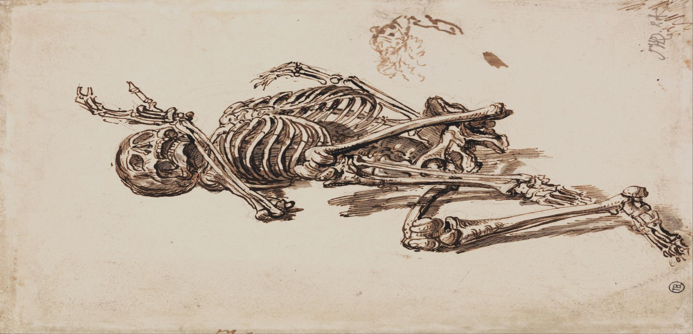
The Termination Thesis (or “TT”) is the view that people go out of existence when they die.
Lots of philosophers seem to believe it.

Slide 3
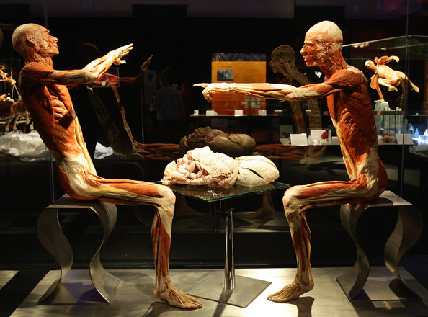
It’s interesting to note that TT has been invoked on both sides of the debate about the evil of death.
Death is not an evil: Epicurus et al. claim (approximately) that since we cease to exist when we die, and nothing can harm us when we don’t exist, death cannot harm us. Thus, it is irrational to fear death.
Death is an evil: When we no longer exist, we are incapable of pursuing the projects that give meaning to our lives. Thus, death harms us.

Slide 4
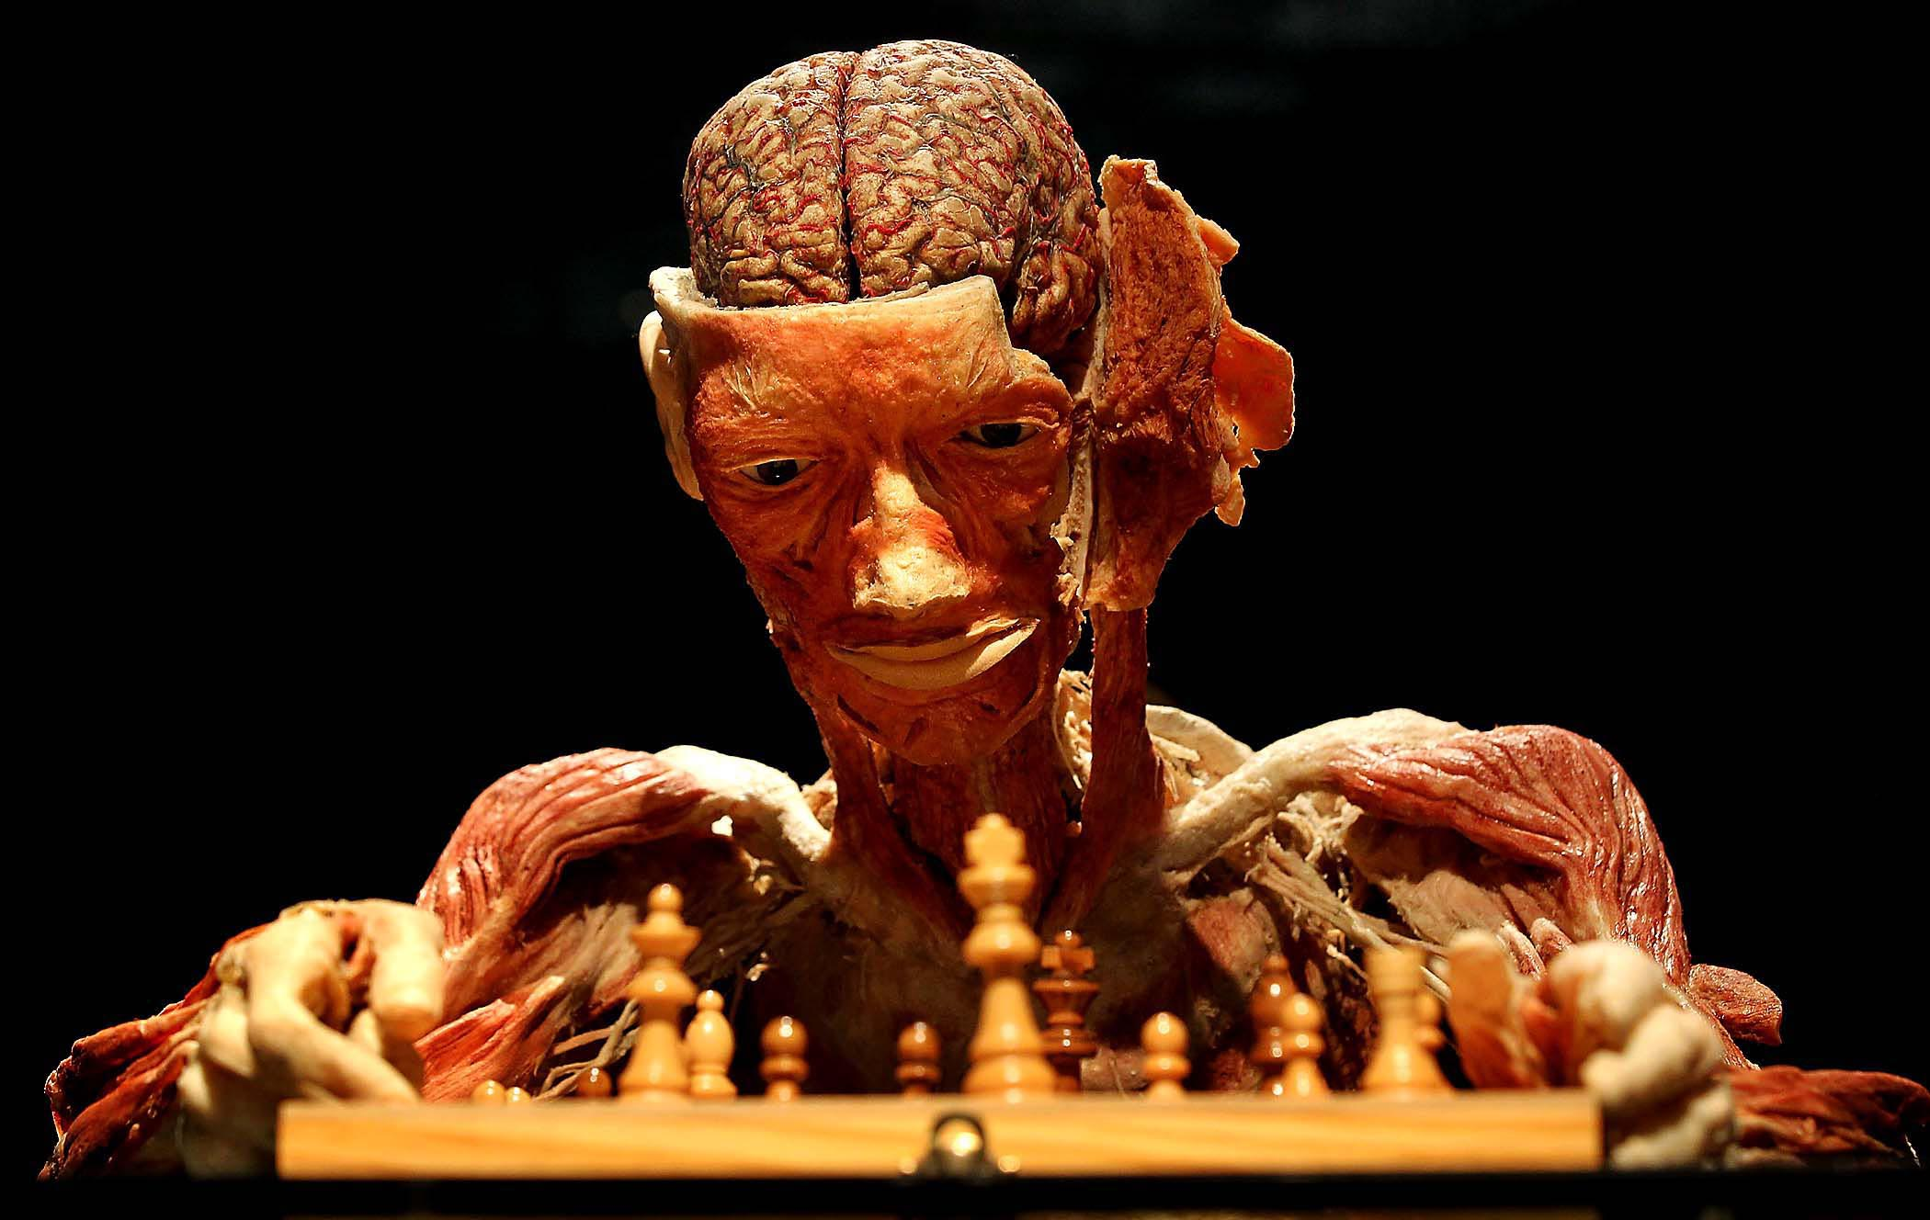
There is the question whether psychological connectedness is the mark of personal identity.
Another question is whether we can live again after we have died.
There is also a question about the relation between a person and his “remains.” Is this relation identity, or is it rather a relation that holds between an entity and another entity into which the former has “substantially changed”?
In any case, it should be clear that TT plays some role in a variety of important metaphysical debates.

Slide 5
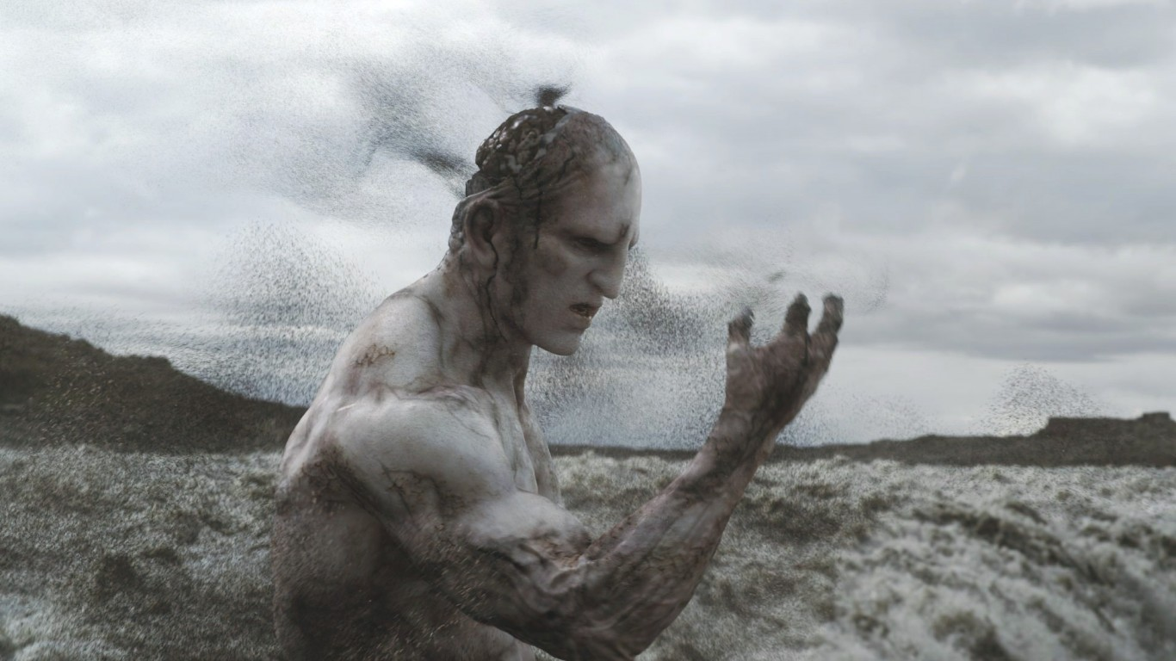
Possible Misunderstandings of TT
It’s easy to mistake TT for the view that when a person dies, he or she ceases to exist “as a person.”
But this view is distinct from TT, for TT is not the view that people cease to exist “as people” when they die. It is the view that they cease to exist simpliciter when they die.
TTs: When a person dies, he or she ceases to exist simpliciter.
TTp: When a person dies, he or she ceases to exist as a person.
TTp follows immediately from the assumption about the concept of personality and the fact that people cease to be alive or self-conscious when they die.

Slide 6
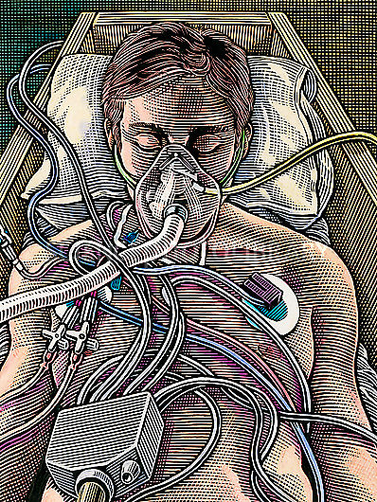
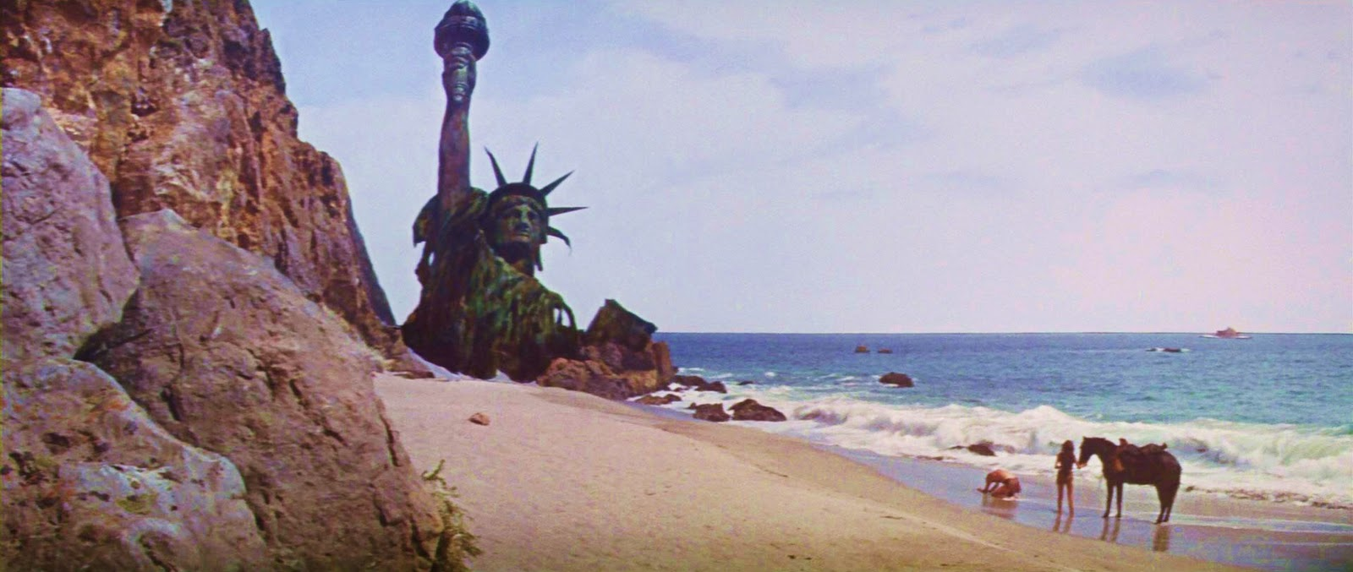
Let’s say that something ceases to exist simpliciter at a time if it simply goes out of existence at that time.
In the typical case, a thing ceases to exist simpliciter at a time if it exists for a while up to that time, but exists no longer after that time.
On the other hand, in the typical case we can say that something ceases to exist as a person at a time if it was a person for a while up to that time but stopped being a person then.

Slide 7
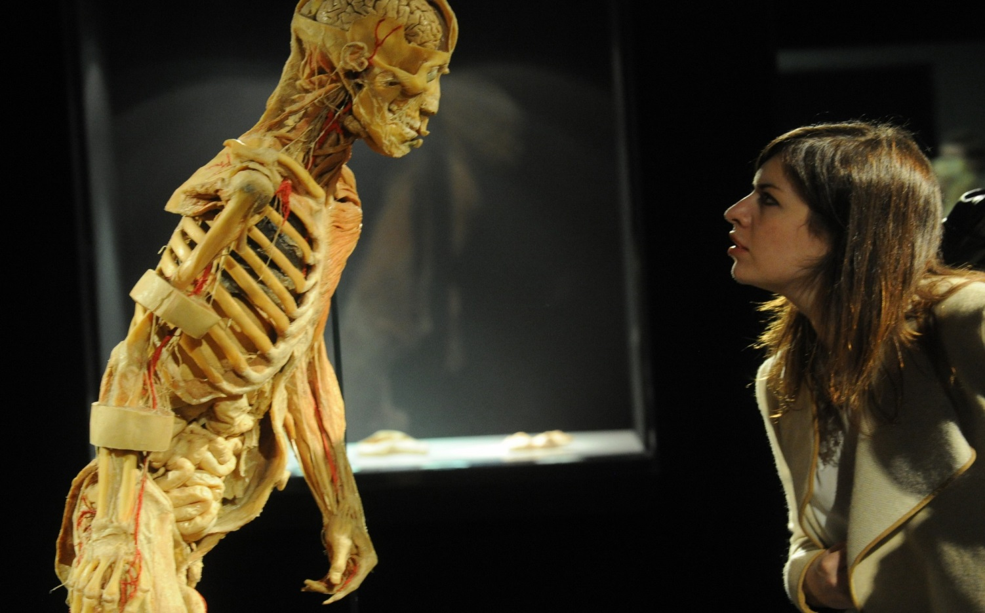
Possible Misunderstandings of TT
It’s also easy to confuse TT with the view that when a person dies, he or she ceases to have any sort of moral or psychological importance.
TTi: When a person dies, he or she ceases to have any moral or other significance; being dead is as meaningless as not existing at all.
TT is the view that people simply stop existing when they die. It’s not the claim that being dead is as meaningless as not existing; it’s the claim that when you are dead, you don’t exist at all.

Slide 8
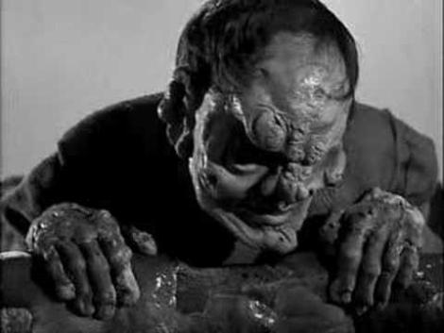
Possible Misunderstandings of TT
TTc: “When I die, I will no longer exist. I will just be a corpse.”
Such a remark seems self-contradictory.
TT is not the view that when people die, they cease existing as the same kind of thing they formerly were.
TT implies that when a person dies, he or she ceases existing as any kind of thing, since he or she ceases existing altogether.

Slide 9
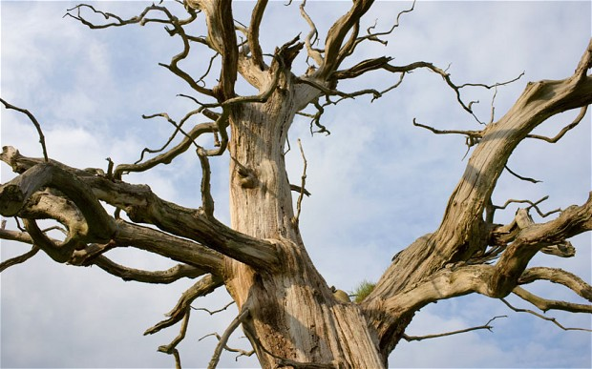
Why I Think TT Is False
It seems to me that what’s true of trees is true of every other sort of organism. In every case, if an organism dies, but its remains remain, then it remains.
The transition from being alive to being dead is a transition that happens to some persisting object.

Slide 10
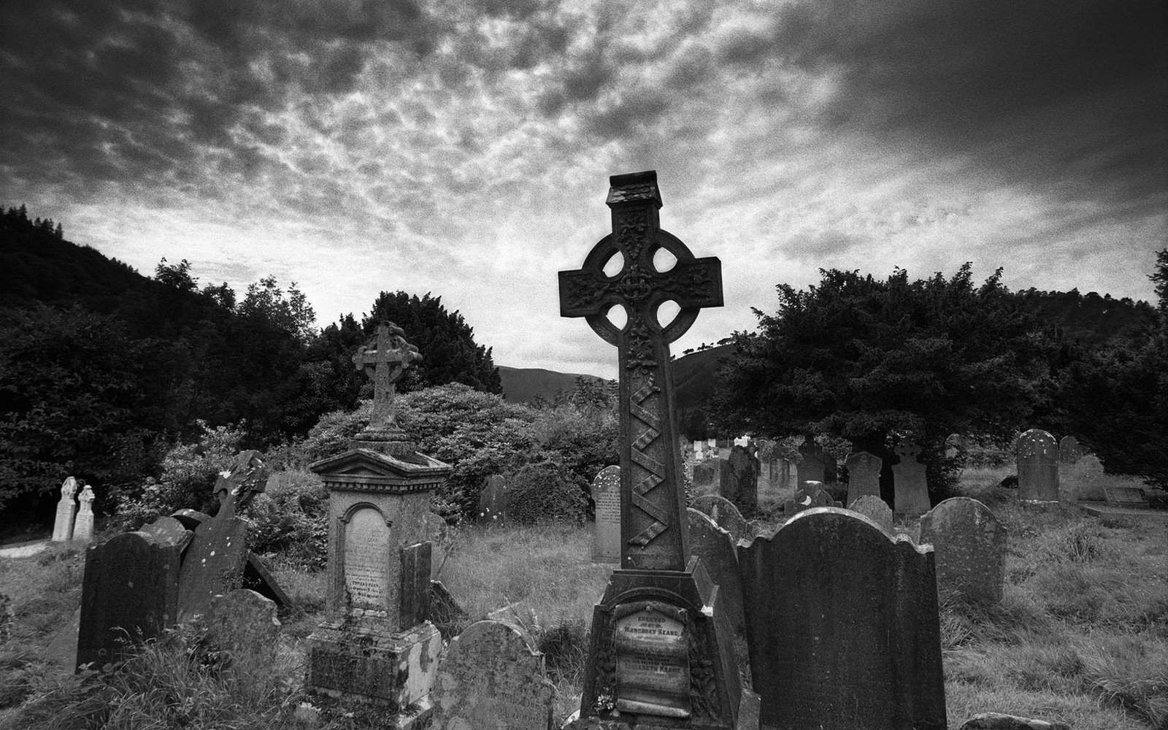
Why I Think TT Is False
On these stones I often see the words “Here lies” followed by the name of the deceased. I believe that in many cases the claim inscribed on the gravestone is true. The deceased does indeed lie (dead) in the grave.

Slide 11
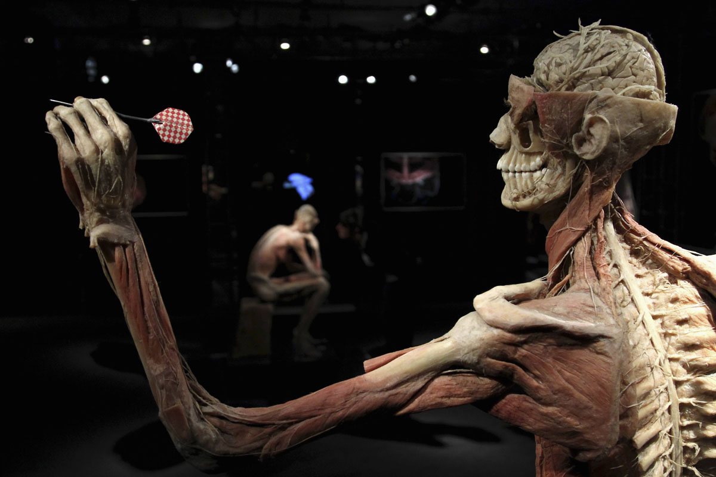
Why I Think TT Is False
I think we are our bodies. If this sort of materialism is true, then I am my body. In that case, I must have the same history as my body.
Since my body will go on existing for a while after I die (unless I die in a remarkably violent way), I will go on existing after I die.

Slide 12
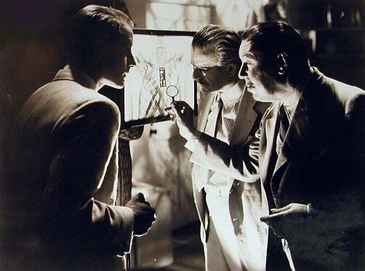
Why I Think TT Is False
In some cases there is reason to wonder about why a person died.
I can readily imagine that there might be a person who is hit by a bullet on one occasion and then later dies as a result of a stroke. I can readily imagine that an autopsy might be performed on this dead person and that the medical examiner might then remove the long-embedded bullet. The object that formerly was a living person still exists—now as a corpse—and still contains the bullet.
If such a thing could happen, then TT is false.

Slide 13
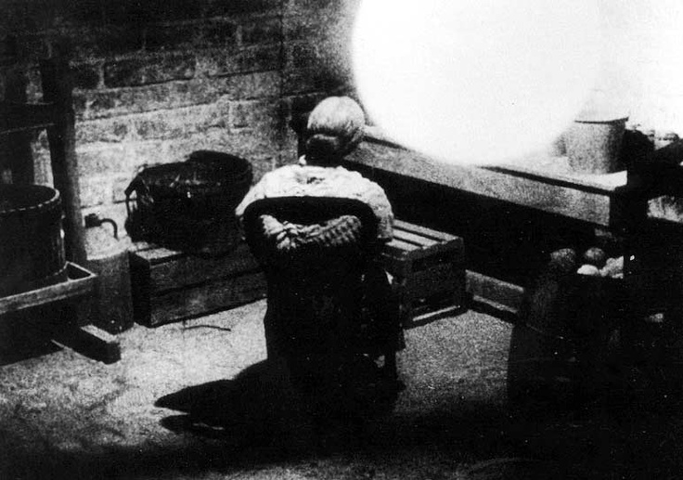
Why I Think TT Is False
One morning, my friend found her mother sitting in her accustomed chair, apparently resting. My friend spoke to her mother, encouraging her to have some breakfast. The mother did not respond. Eventually my friend became concerned and checked more closely. She found that her mother had been dead all the while.
If TT were true, the object in the chair that morning was not my friend’s mother. My friend’s mother would have gone out of existence sometime during the night, only to be replaced by some strange entity never before seen by my friend.

Slide 14
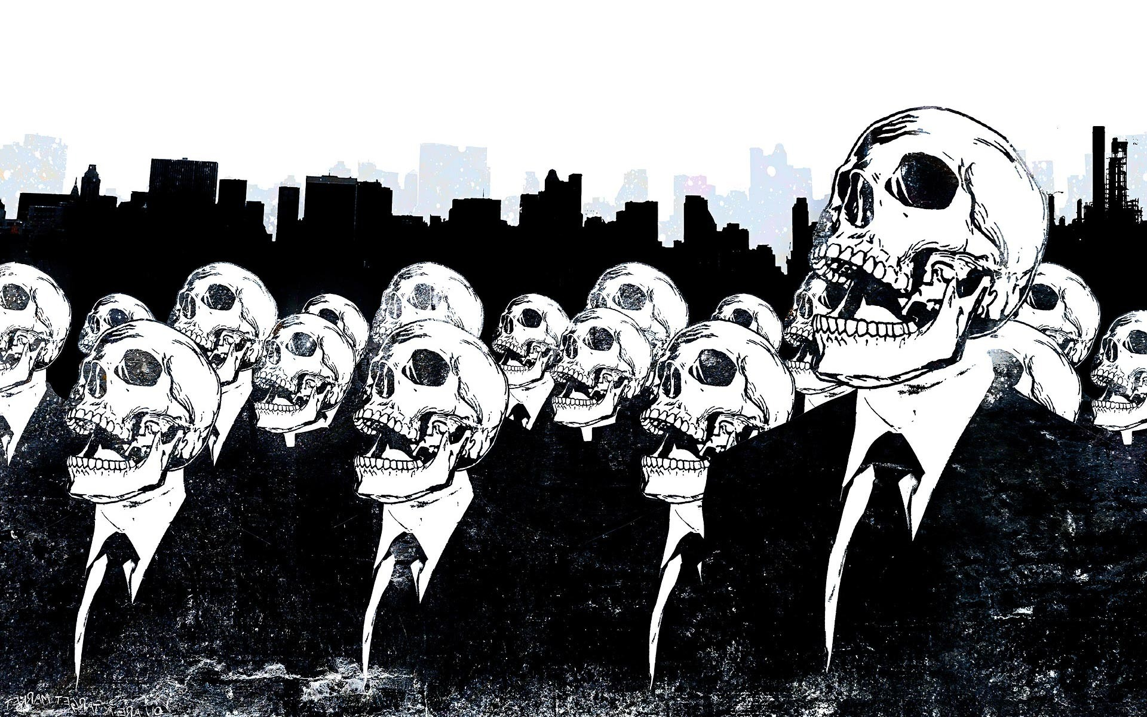
Why I Think TT Is False
Imagine a case in which a person was dressed in a tight-fitting, hard-to-button suit at the time of death. The corpse is discovered dressed in the same outfit.
How did the person get out of the suit without unbuttoning the buttons and unzipping the zippers? How did the corpse get in there?
If TT is true, these things must have happened.

Slide 15
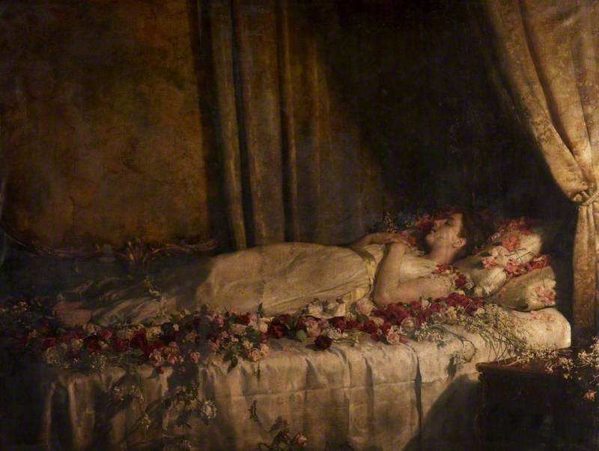
Some Arguments for TT
Suppose someone thought that the concept of death is the concept of the annihilation of a living organism. Then there would be a quick argument to the conclusion that people go out of existence when they die:
x dies at t = df. x is a living organism up to t & x is annihilated at t.
If (1) is true, then people go out of existence when they die.
Therefore, people go out of existence when they die.

Slide 16
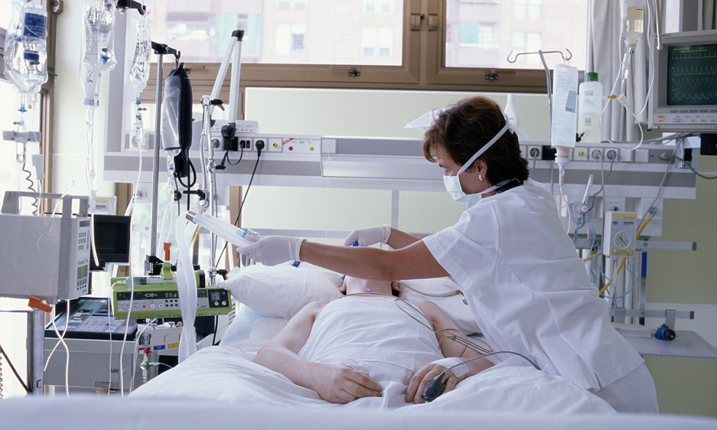
Some Arguments for TT
Other lines of argument for TT depend more heavily on alleged features of the concept of being a person or what I will call “personality.”
When a person dies, he or she ceases to be a person.
When a person ceases to be a person, he or she ceases to exist.
Therefore, when a person dies, he or she ceases to exist.

Slide 17
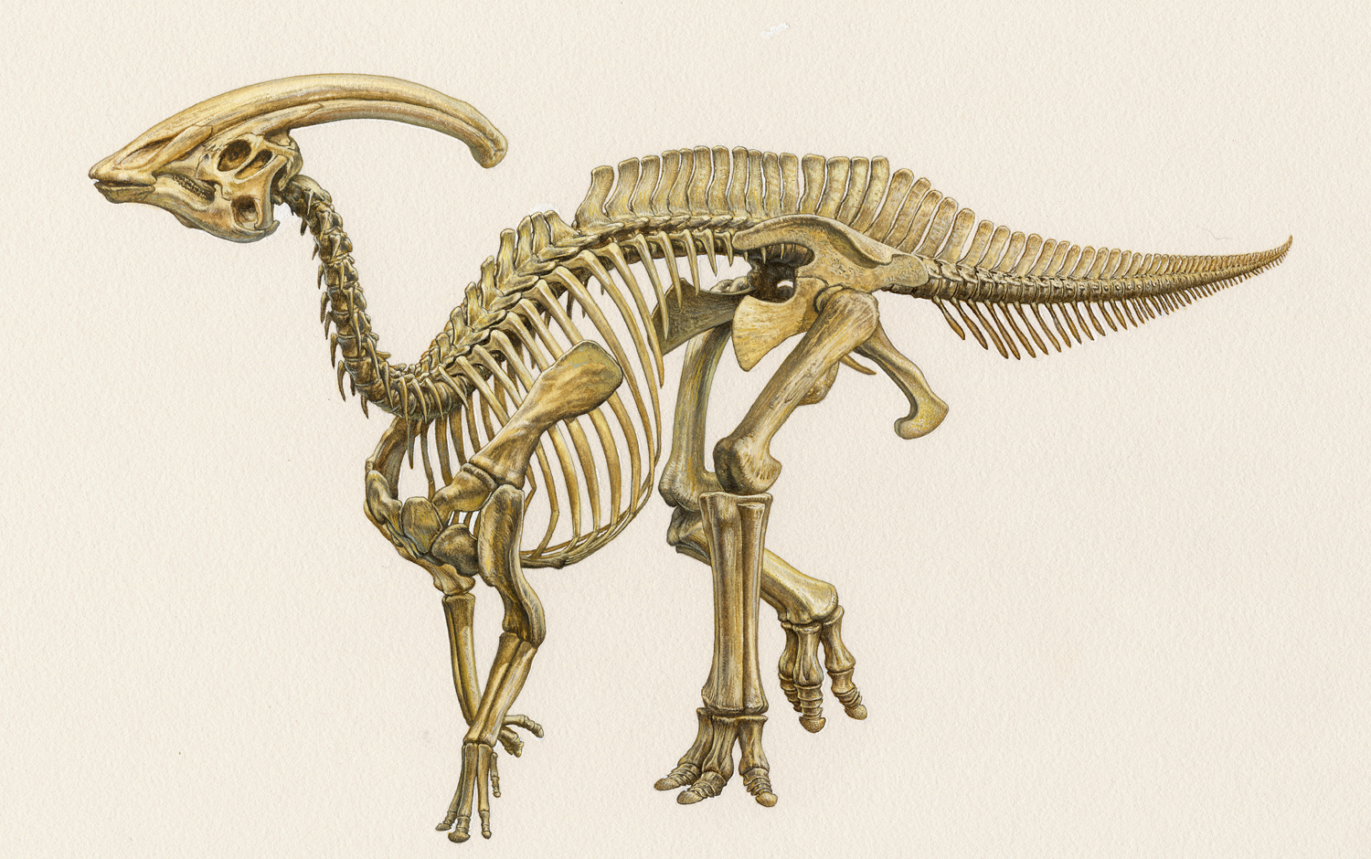
Some Arguments for TT
Another line of argument for TT is based on the idea that certain essential properties are lost at death. If the property of being alive, for example, were an essential property of the things that have it, then it would follow that something goes out of existence whenever something loses its life.

Slide 18
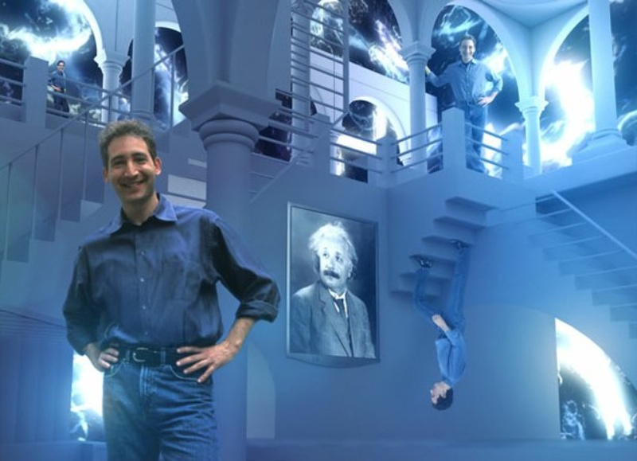
Personal Temporal Segments
A philosopher might try to construct a metaphysical scheme that will force TT to come out true. He could start by adopting a metaphysical principle:
TP: If a physical object lasts through a stretch of time, then for every substretch of that time, it has a temporal segment that lasts precisely through that substretch.

Slide 19
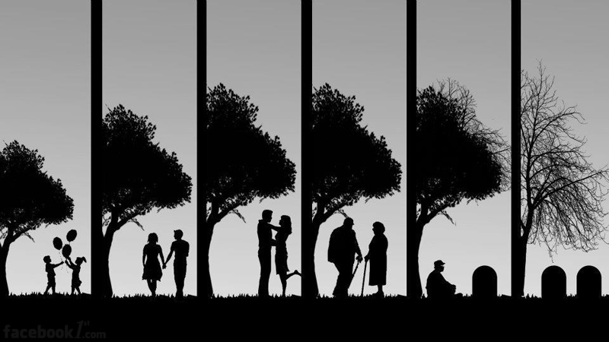
Consider some human body. Suppose it lasts for a hundred years. Suppose it is fetal for the first few months, then infantile, then adolescent, then mature, then elderly, and then dead for a while.
None of these temporal segments is strictly identical to the body. Their diversity follows from their differences in temporal extent. But of course it would be somewhat misleading to say, for example, that the mature-segment is a “completely different thing” from the body.
Some persons continue to exist after they die; they just stop being persons and start being dead human bodies.

Slide 20
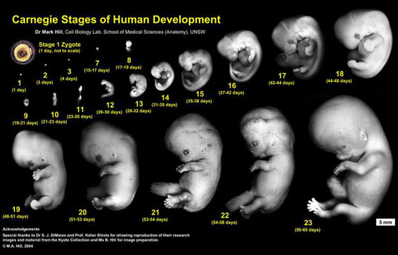
Another philosopher might take a more radical approach. He might say that as he uses the term “person,” it correctly applies to a thing only if that thing has the person-making property throughout its existence.
Furthermore, he might insist that nothing is properly called a person unless it is “maximal” in this sense: it is not a proper temporal part of any larger segment that has the person-making property throughout its existence.

Slide 21
The radical view grants that the thing I call “me” exists. Advocates of the radical view may call such things “human bodies.” But the radical view insists that these entities are not absolute persons. They are temporally larger items that contain absolute persons as proper temporal segments.

Slide 22
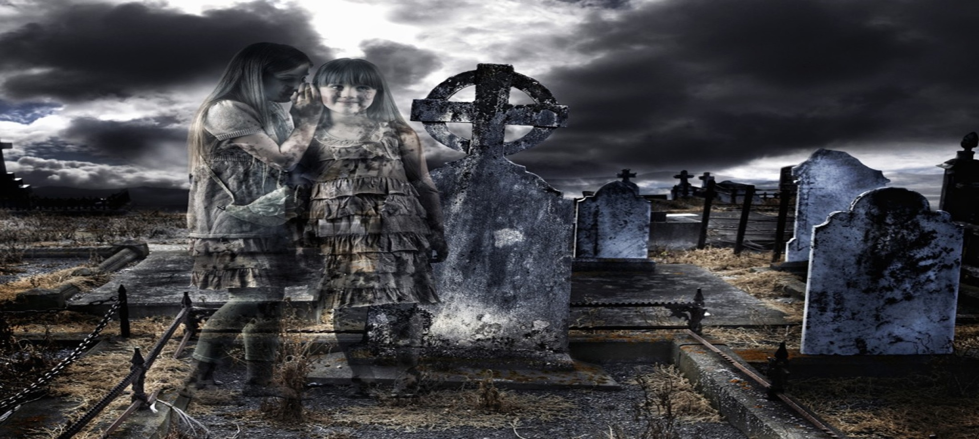
Perhaps when one of them uses the word “I” to refer to himself, he means to refer to an entity that will go out of existence at death.
If they do this, they are thinking of themselves as things that are, on my view, mere parts of things like me and my friends.
My friends and I are things like us, and we won’t go out of existence when we die.

